Slide 1
FIVE FUNDAMENTALS OF PROGRESS
STABILITY
ADAPTABILITY
PURIFICATION
INTEGRATION
GROWTH
Notes:
Like the 16 principles, the 5 Fundamentals of Progress help to put in clear, simple terms, principles for how we can best progress through life. We can find this pattern of progress throughout nature. They are simple reminders of what is needed.
Overview:
Stability is the ability to maintain balance. It is firmness, constancy. Stability is a solid foundation, unshakeable.
Adaptability - the quality of being able to adjust to new conditions. The ability to change when necessary and useful.
Purification - an act or instance of freeing from impurities, or of being freed from impurities
Integration : the act or process of uniting different things. : the combining and coordinating of separate parts or elements into a unified whole:
Growth- continuous mental, physical, and/or spiritual development: Evolution, expansion, maturing

Slide 2


STABILITY
Notes:
Stability is the ability to maintain balance. It is firmness, constancy. Stability is a solid foundation, unshakeable. How do humans find that kind of stability?

Slide 3

Notes:
We change constantly throughout our life. There are so many versions of us - So where do we find stability? Change is constantly going on within us, and all around us. This is sometimes called the “Relative”, relative life, where not much seems constant, not even our identity. Some things may remain somewhat stable like our belief in our God, or our relationships with our family, but even those family ties will someday change, and it can shake our sense of who we are. So to be strong from within it helps if our stability, our identity, comes from an even deeper level that is beyond change.

Slide 4

Notes:
Transcendental Consciousness is a field of complete silence — what can be called an “Absolute” level of existence that is a field of non-change Enlivening this field brings a stabilizing influence to our life. Transcendental Consciousness has always been a part of us, but it was unknown. It is enlivened through TM and other experiences that support transcendence — and in time becomes a stable foundation of all the changing phases of life. We begin to experience that silent, unchanging, absolute level of life along with our changing, dynamic Relative lives.

Slide 5
“The Absolute and the relative are the two phases of existence. Unless they are brought together the Absolute remains transcendental, beyond the field of activity, out of sight and seemingly of no practical value; while the field of relative life is over-strained by constant activity and in its unstable, ever-changing status remains weak.” (Maharishi,1963, p. 94)
Notes:
2. We put the 2 together and we are stronger. This is what everyone needs – to be strong and stable come what may.

Slide 6
Stability in the individual and workplace –
This is seen in the qualities of steadfastness, constancy,
reliability. Stability is gained through preserving the core values of the the individual and organization (practices and strategies may change, but core values should remain constant).
Healthy presence of stability within an organization: inner stability would provide the confidence and boldness to try something different, alignment between individual values, individual behavior, organizational culture and values, and organizational behavior and policies.
Notes:
Stability is the basis here for the healthy existence of the other qualities.

Slide 7

ADAPTABILITY
Notes:
Adaptability - the quality of being able to adjust to new conditions. The ability to change when necessary and useful.

Slide 8
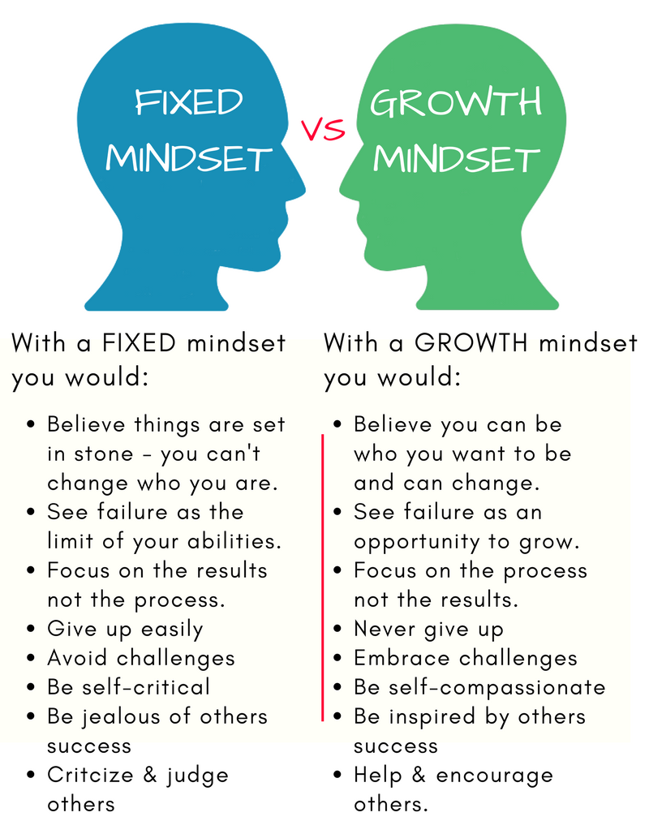
ADAPTABILITY

Slide 9
Adaptability in the individual and workplace –
The ability to adapt to changing external market conditions and internal needs and capacities of the workplace.
Healthy presence of adaptability within an organization: open to new possibilities; trying lots of things and seeing what works; strategic operations and decision making; company is current and competitive; creative, diverse, and resilient.

Slide 10

PURIFICATION
Notes:
Purification - an act or instance of freeing from impurities or of being freed from impurities

Slide 11

PURIFICATION
Notes:
We purify out those elements that are not really a part of us, that hide our true self —Those elements that slow us down and are not useful, that may hurt us or hurt others, or hurt our chances for growth. We can purify ourselves through our diet, sleep, our activities and through TM.

Slide 12
Purification in the individual and workplace –
The ability to discontinue types of behavior or activities that are not producing the results that are wanted.

Slide 13

INTEGRATION
Notes:
Integration : the act or process of uniting different things. : the combining and coordinating of separate parts or elements into a unified whole:
Pierre-Simon Laplace - “Nature laughs at the difficulties of integration”.
Nature integrates even opposites to create perfection.
But it is a little more challenging for humans.

Slide 14
INTEGRATION
To be a person of integrity, both personally and professionally, all the elements of our life must be integrated.

Slide 15




INTEGRATION
Action and Speech
Thinking
Intuition and Feeling
Transcendental
Notes:
We have to integrate all the different layers of our self.
If we’re not Integrated, and functioning as a whole, then it’s difficult to behave with integrity. The different parts of us may want different things. We can then make promises we can’t keep.
Life gets complicated – there are so many pieces! And if we are also just a collection of unintegrated pieces it’s easy to get lost.
So the art of integration is important to cultivate.

Slide 16
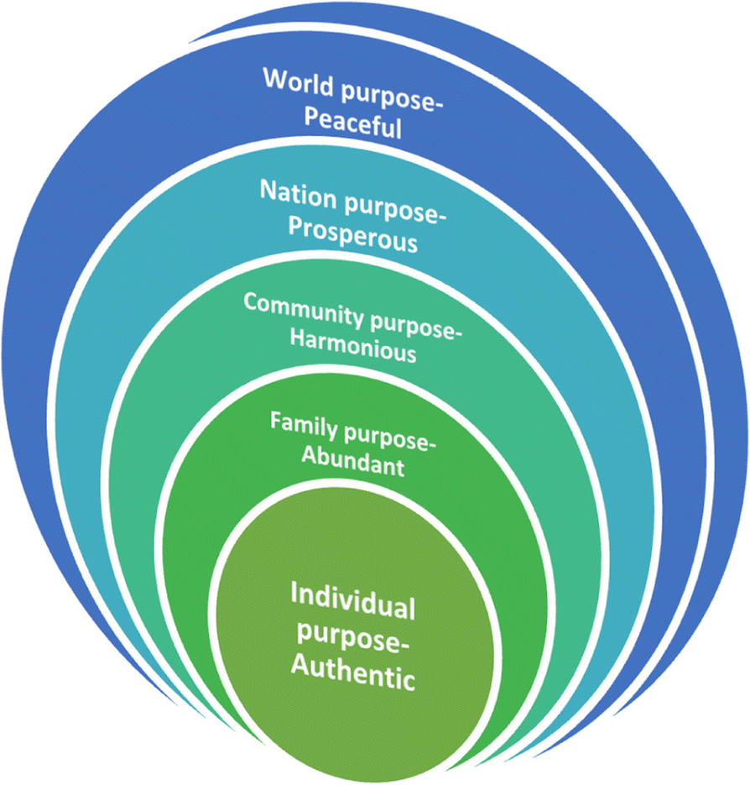
Notes:
There are also the levels of our life that extend outward.
The vast range of the individual’s life – and all these levels need to be integrated. This calls for a lot of integrity.

Slide 17
Integration in the individual and workplace –Integration enables the introduction of new ideas or approaches into the established patterns of functioning; bringing new and old ideas together.

Slide 18

GROWTH
Notes:
Growth- progressive development : Evolution, increase, expansion, maturing
The Nature of Life is to Grow. We always want to be taking that upward direction in life.

Slide 19

GROWTH
Notes:
To be really effective, we have to water the root.

Slide 20
Growth in the individual and workplace – Continuous mental, physical, and spiritual development, for the individuals that make up the company and for the company as a whole.

Slide 21
IN A STATISTICAL META-ANALYSIS OF 42 INDEPENDENT STUDIES ON TM, the components measured included:
Increased Emotional Maturity — Stability, Purification
Increased Self-Regard and Self-Acceptance — Stability, Purification
Increased Resilient Sense of Self — Adaptability, Purification
Increased Flexibility in Application of Values — Adaptability, Purification
Increased Positive, Integrated Perspective
of Self and the World — Integration, Purification
Increased Ability to See Opposites of Life
as Meaningfully Related — Integration, Purification
Increased Ability to Live in the Present — Growth
These findings demonstrate that growth towards higher stages of human development is possible for anyone. (Alexander, et al., 1991)
Notes:
Purification is added to all these because that is a constant need, to keep the other principles lively and functioning at their best.

Slide 22
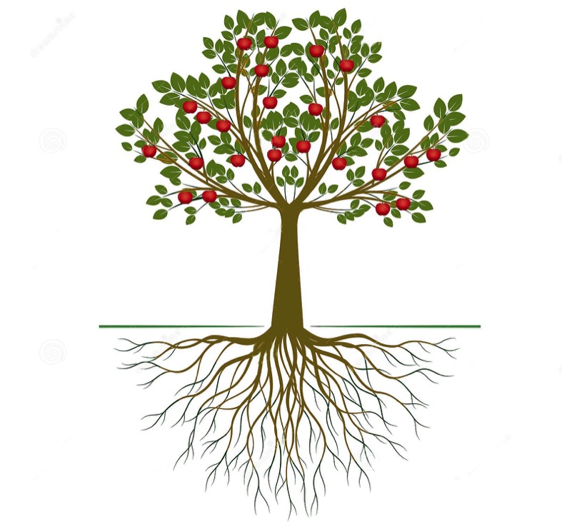
FIVE FUNDAMENTALS OF PROGRESS
STABILITY
ADAPTABILITY
PURIFICATION
INTEGRATION
GROWTH

